Slide 2


Slide 3

CS15 Mixer
This Wednesday, September 11 in CIT 3rd floor atrium, from 5-6PM
Get to know the15 TA staff!
Drinks and light snacks will be provided

Slide 4
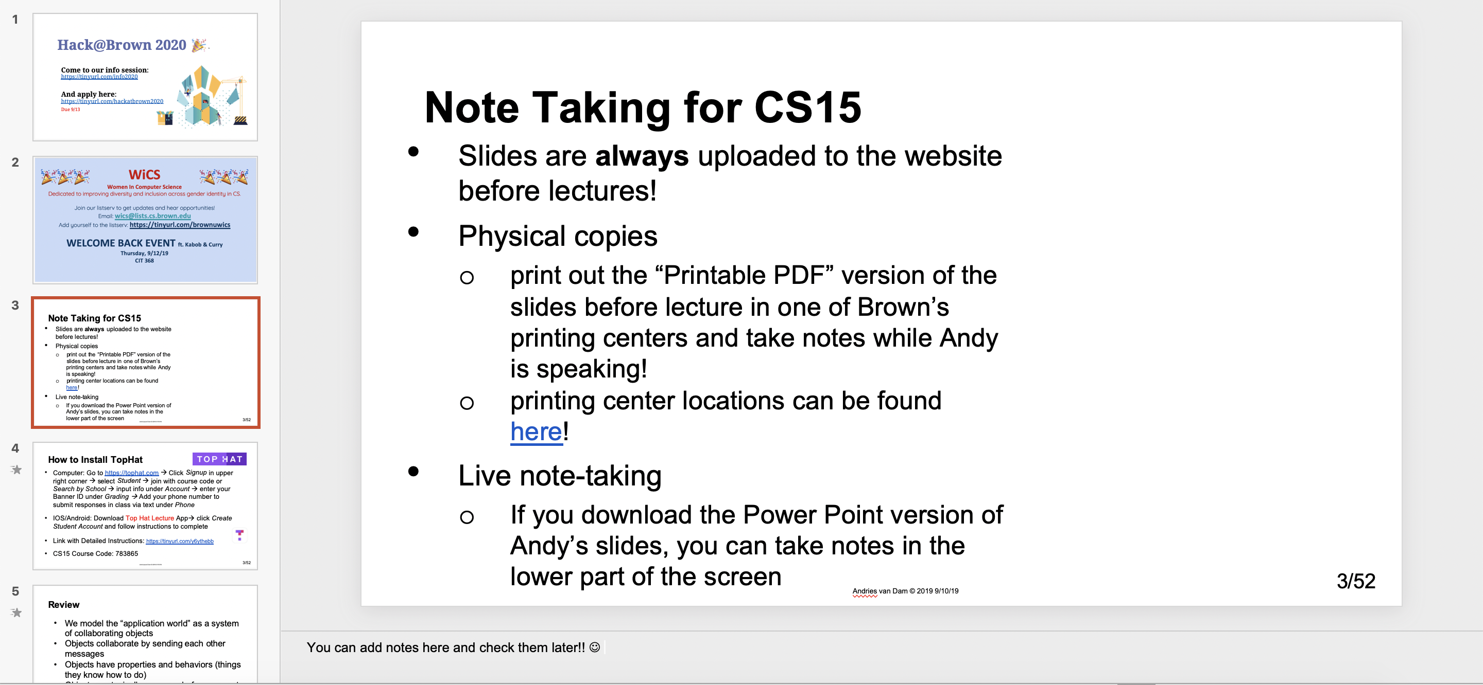
Note Taking for CS15
Slides are always uploaded to the website before lectures!
Physical copies
print out the “Printable PDF” version of the slides before lecture in one of Brown’s printing centers and take notes while Andy is speaking!
printing center locations can be found here!
Live note-taking
If you download the Power Point version of Andy’s slides, you can take notes in the lower part of the screen
My own notes from CS15!
Notes:
You can add notes here and check them later!! ☺

Slide 5


How to Install TopHat
Computer: Go to https://tophat.com → Click Signup in upper right corner → select Student → join with course code or Search by School → input info under Account → enter your Banner ID under Grading → Add your phone number to submit responses in class via text under Phone
IOS/Android: Download Top Hat Lecture App→ click Create Student Account and follow instructions to complete
Link with Detailed Instructions: https://tinyurl.com/y6ythebb
CS15 Course Code: 783865

Slide 6
Review
We model the “application world” as a system of collaborating objects
Objects collaborate by sending each other messages
Objects have properties and behaviors (things they know how to do)
Objects are typically composed of component objects

Slide 7
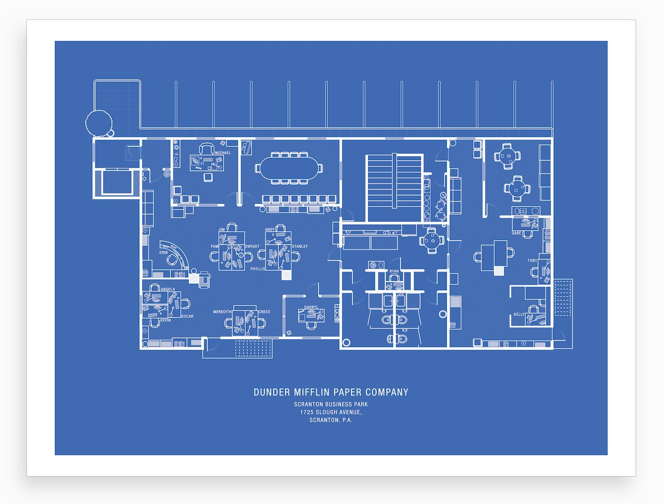
Lecture 2
Calling and Defining Methods in Java

Slide 8
Outline
Calling methods
Declaring and defining a class
Instances of a class
Defining methods
The this keyword

Slide 9


Meet samBot
(kudos to former headTA Sam Squires)
samBot is a robot who lives in a 2D grid world
She knows how to do two things:
move forward any number of steps
turn right 90º
We will learn how to communicate with samBot using Java
I created SamBot!

Slide 10


samBot’s World
0
1
2
3
4
This is samBot’s world
samBot starts in the square at (0,0)
She wants to get to the square at (1,1)
Thick black lines are walls samBot can’t pass through
0
1
2
(2,4)

Slide 11
Giving Instructions (1/3)
Goal: move samBot from starting position to destination by giving her a list of instructions
samBot only knows how to “move forward n steps” and “turn right”
What instructions should be given?
0
1
2
3
4
0
1
2

Slide 12
Giving Instructions (2/3)
Note: samBot moves in the direction her outstretched arm is pointing. Yes, she can move sideways and upside down in this 2D world!
“Move forward 4 steps.”
0
1
2
3
4
“Turn right.”
0
“Move forward 1 step.”
1
“Turn right.”
“Move forward 3 steps.”
2

Slide 13
Giving Instructions (3/3)
0
1
2
3
4
Instructions have to be given in a language samBot knows
That’s where Java comes in!
In Java, give instructions to an object by giving it commands
0
1
2

Slide 14
“Calling Methods”: Giving Commands in Java (1/2)
samBot can only handle commands she knows how to respond to
These responses are called methods!
“method” is short for “method for responding to a command”. Therefore, whenever samBot gets a command, she can respond by utilizing a method.
Objects cooperate by giving each other commands
caller is the object giving the command
receiver is the object receiving the command

Slide 15

“Calling Methods”: Giving Commands in Java (2/2)
samBot already has one method for “move forward n steps” and another method for “turn right”
When we send a command to samBot to “move forward” or “turn right” in Java, we are calling a method on samBot.
Hey samBot, turn right!
method call (command passed from caller to receiver)
caller
receiver (samBot)

Slide 16
Turning samBot right
Names don’t have spaces!
Style guide has capitalization conventions, e.g., camelCase
samBot’s “turn right” method is called turnRight
To call the turnRight method on samBot:
samBot.turnRight();
To call methods on samBot in Java, need to address her by name!
Every command to samBot takes the form:
samBot.<method name(…)>;
What are those parentheses at the end of the method for?
You can substitute anything in < >!
; ends Java statement

Slide 17
Moving samBot forward
Remember: when telling samBot to move forward, you need to tell her how many steps to move
samBot’s “move forward” method is named moveForward
To call this method in Java:
samBot.moveForward(<number of steps>);
This means that if we want her to move forward 2 steps, we say:
samBot.moveForward(2);

Slide 18
Calling Methods: Important Points
Method calls in Java have parentheses after the method’s name
In the definition of the method, extra pieces of information to be passed into the method are called parameters; in the call to the method, the actual values passed in are called arguments
e.g. : in defining f(x), x is the parameter; in calling f(2), 2 is the argument
more on parameters and arguments next lecture!
If the method needs any information, include it between the parentheses (e.g., samBot.moveForward(2);)
If no extra information is needed, just leave the parentheses empty (e.g., samBot.turnRight();)

Slide 19
Guiding samBot in Java
Tell samBot to move forward 4 steps
Tell samBot to turn right
Tell samBot to move forward 1 step
Tell samBot to turn right
Tell samBot to move forward 3 steps
→ samBot.moveForward(4);
→ samBot.turnRight();
→ samBot.moveForward(1);
→ samBot.turnRight();
→ samBot.moveForward(3);
0
1
2
3
4
“pseudocode”
Java code
0
1
2

Slide 20

Hand Simulation
Simulating lines of code by hand checks that each line produces correct action
we did this in slide 7 for pseudocode
In hand simulation, you play the role of the computer
lines of code are “instructions” for the computer
try to follow “instructions” and see if you get desired result
if result is incorrect:
one or more instructions or the order of instructions may be incorrect

Slide 21
Hand Simulation of This Code
0
1
2
3
4
samBot.moveForward(4);
samBot.turnRight();
samBot.moveForward(1);
samBot.turnRight();
samBot.moveForward(3);
0
1
2

Slide 22

About TopHat Questions
Increase engagement during lecture!
We encourage working with a neighbor and discussing concepts on all TopHat questions
Can use app, website
If you need an device to access TopHat, you can borrow a laptop from the IT Service Center on 5th floor of Page-Robinson Hall.
TopHat questions are worth 5% of your grade! (See course missive)

Slide 23
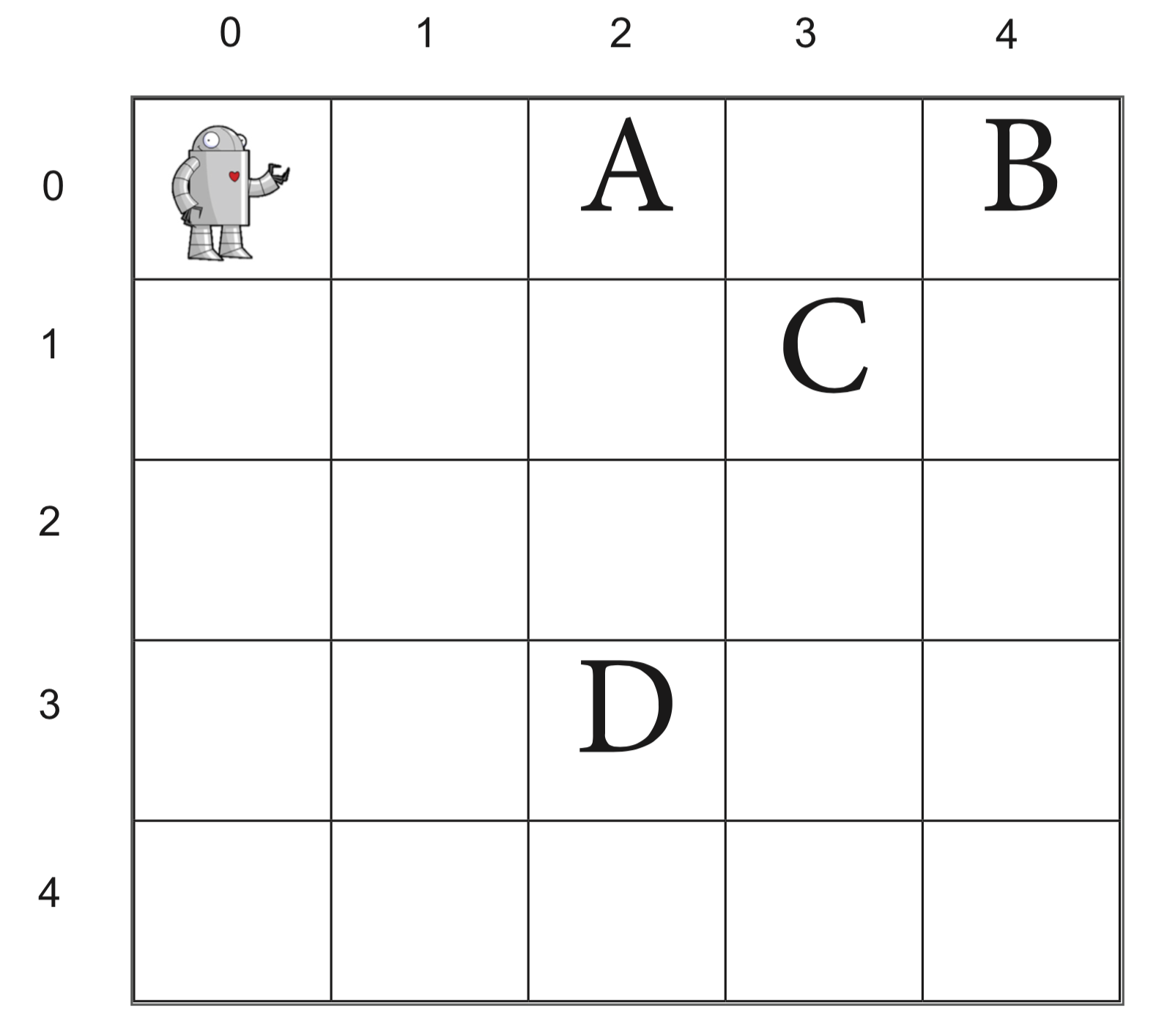
TopHat Question
Where will samBot end up when this code is executed?
samBot.moveForward(3);
samBot.turnRight();
samBot.turnRight();
samBot.moveForward(1);
A
B
C
D
Choose one of the positions or
E: None of the above

Slide 24
Putting Code Fragments in a Real Program (1/2)
Let’s demonstrate this code for real
First, put it inside real Java program
Grayed-out code specifies context in which an arbitrary robot named myRobot executes instructions
it is part of the stencil code written for you by the TAs, which also includes samBot’s or any other robot’s capability to respond to moveForward and turnRight− more on this later
public class RobotMover {
/* additional stencil code elided*/
public void moveRobot(Robot myRobot) {
myRobot.moveForward(4);
myRobot.turnRight();
myRobot.moveForward(1);
myRobot.turnRight();
myRobot.moveForward(3);
}
}
comment

Slide 25
Putting Code Fragments in a Real Program (2/2)
We’re about to explain this part of the code!
public class RobotMover {
/* additional code elided */
public void moveRobot(Robot myRobot) {
myRobot.moveForward(4);
myRobot.turnRight();
myRobot.moveForward(1);
myRobot.turnRight();
myRobot.moveForward(3);
}
}
Before, we’ve talked about objects that handle messages with "methods"
Introducing a new concept… classes!

Slide 26
What is a class?
A class is a blueprint for a certain type of object
An object’s class defines its properties and capabilities (methods)
more on this in a few slides!
Let’s embed the moveRobot code fragment (method) that moves samBot (or any other Robot instance) in a new class called RobotMover
Need to tell Java compiler about RobotMover before we can use it
public class RobotMover {
/* additional code elided */
public void moveRobot(Robot myRobot) {
myRobot.moveForward(4);
myRobot.turnRight();
myRobot.moveForward(1);
myRobot.turnRight();
myRobot.moveForward(3);
}
}

Slide 27
Declaring and Defining a Class (1/3)
Like a dictionary entry, first declare term, then provide definition
First line declares RobotMover class
Breaking it down:
public indicates any other object can use instances of this class
class indicates to Java compiler that we are about to define a new class
RobotMover is the name we have chosen for our class
declaration of the RobotMover class
public class RobotMover {
/* additional code elided */
public void moveRobot(Robot myRobot) {
myRobot.moveForward(4);
myRobot.turnRight();
myRobot.moveForward(1);
myRobot.turnRight();
myRobot.moveForward(3);
}
}
Note: public and class are Java “reserved words” aka “keywords” and have pre-defined meanings in Java; use Java keywords a lot in the future

Slide 28
Declaring and Defining a Class (2/3)
Class definition (aka “body”) defines properties and capabilities of class
it is contained within curly braces that follow the class declaration
A class’s capabilities (“what it knows how to do”) are defined by its methods – RobotMover thus far only shows one specific method, moveRobot
A method is a declaration followed by its body (also enclosed in {…} braces)
A class’s properties are defined by its instance variables – more on this next week
public class RobotMover {
/* additional code elided */
public void moveRobot(Robot myRobot) {
myRobot.moveForward(4);
myRobot.turnRight();
myRobot.moveForward(1);
myRobot.turnRight();
myRobot.moveForward(3);
}
}
definition of moveRobot method
definition of RobotMover class

Slide 29
Declaring and Defining a Class (3/3)
General form for a class:
<visibility> class <name> {
<code (properties and capabilities) that defines class>
}
declaration
definition
to make code more compact, typically put opening brace on same line as declaration -- Java compiler doesn’t care
Each class goes in its own file, where name of file matches name of class
RobotMover class is contained in file “RobotMover.java”

Slide 30

The Robot class (defined by the TAs)
Note: Normally, support code is a “black box” that you can’t examine
public class Robot {
public void turnRight() {
// code that turns robot right
}
public void moveForward(int numberOfSteps) {
// code that moves robot forward
}
/* other code elided-- if you’re curious, check out Robot.java in the stencil code!*/
}
in-line comment
public class Robot declares a class called Robot
Information about the properties and capabilities of Robots (the class definition) goes within the red curly braces

Slide 31
Methods of the TA's Robot class
public void turnRight() and public void moveForward(int numberOfSteps) each declare a method
more on void later!
moveForward needs to know how many steps to move, so the parameter is int numberOfSteps within parentheses
int tells compiler this parameter is an “integer” (we say “moveForward takes a single parameter called numberOfSteps of type int”)
public class Robot {
public void turnRight() {
// code that turns robot right
}
public void moveForward(int numberOfSteps) {
// code that moves robot forward
}
/* other code elided-- if you’re curious, check out Robot.java in the stencil code!*/
}

Slide 32

Classes and Instances (1/4)
samBot is an instance of class Robot
this means samBot is a particular Robot that was built using the Robot class as a blueprint (another instance could be dwightBot)
All Robots (all instances of the class Robot) have the exact same capabilities: the methods defined in the Robot class. What one Robot instance can do, they all can do since they are made with the same blueprint!
All Robots also have the exact same properties (i.e., every Robot has a Color and a Size)
they all have these properties but the values of these properties may differ between instances (e.g., a big samBot and small dwightBot)

Slide 33

Classes and Instances (2/4)
The Robot class is like a blueprint

Slide 34



Classes and Instances (3/4)
We can use the Robot class to build actual Robots - instances of the class Robot, whose properties (like their color in this case) may vary (next lecture)
samBot
blueBot
pinkBot
greenBot

Slide 35
Classes and Instances (4/4)
Method calls are done on instances of the class. These are four instances of the same class (blueprint).
instance
instance
instance
instance
samBot
blueBot
pinkBot
greenBot

Slide 36
TopHat Question
You know that blueBot and pinkBot are instances of the same class. Let’s say that the call pinkBot.chaChaSlide(); makes pinkBot do the cha-cha slide. Which of the following is true?
The call blueBot.chaChaSlide(); will make blueBot do the cha-cha slide
The call blueBot.chaChaSlide(); might make blueBot do the cha-cha slide or another popular line dance instead
You have no guarantee that blueBot has the method chaChaSlide();

Slide 37
Defining Methods
We have already learned about defining classes, let’s now talk about defining methods
Let’s use a variation of our previous example
0
1
2
3
4
0
1
public class RobotMover {
/* additional code elided */
public void moveRobot(Robot myRobot) {
// Your code goes here!
// …
// …
}
}
2

Slide 38
Declaring vs. Defining Methods
Declaring a method says the class knows how to do some task like pinkBot can chaChaSlide()
Defining a method actually explains how the class completes this task (what command it gives) chaChaSlide() could include: stepping backwards, alternating feet, stepping forward
Usually you will need to both define and declare your methods

Slide 39
A Variation on moveRobot (1/2)
public class RobotMover {
/* additional code elided */
public void moveRobot(Robot myRobot) {
myRobot.turnRight();
myRobot.moveForward(2);
myRobot.turnRight();
myRobot.turnRight();
myRobot.turnRight();
myRobot.moveForward(3);
myRobot.turnRight();
myRobot.turnRight();
myRobot.turnRight();
myRobot.moveForward(2);
myRobot.turnRight();
myRobot.turnRight();
myRobot.turnRight();
myRobot.moveForward(2);
}
}
0
1
2
3
4
0
1
2

Slide 40
A Variation on moveRobot (2/2)
Lots of code for a simple problem..
samBot only knows how to turn right, so have to call turnRight three times to make her turn left
If she understood how to “turn left”, would be much less code!
We can ask the TAs to modify samBot to turn left by declaring and defining a method called turnLeft
public class RobotMover {
/* additional code elided */
public void moveRobot(Robot myRobot) {
myRobot.turnRight();
myRobot.moveForward(2);
myRobot.turnRight();
myRobot.turnRight();
myRobot.turnRight();
myRobot.moveForward(3);
myRobot.turnRight();
myRobot.turnRight();
myRobot.turnRight();
myRobot.moveForward(2);
myRobot.turnRight();
myRobot.turnRight();
myRobot.turnRight();
myRobot.moveForward(2);
}
}
“turn left”
“turn left”
“turn left”

Slide 41
Defining a Method (1/2)
public class Robot {
public void turnRight() {
// code that turns robot right
}
public void moveForward(int numberOfSteps) {
// code that moves robot forward
}
public void turnLeft()
// our code goes here!
}
}
Almost all methods take on this general form:
When calling turnRight or moveForward on an instance of the Robot class, all code between method’s curly braces is executed
explanation in later lecture
<visibility> <type> <name> (<parameters>) {
<list of statements within method>
}

Slide 42
Defining a Method (2/2)
We’re going to define a new method: turnLeft
To make a Robot turn left, tell her to turn right three times
public class Robot {
public void turnRight() {
// code that turns robot right
}
public void moveForward(int numberOfSteps) {
// code that moves robot forward
}
public void turnLeft() {
//The TA’s code goes here!!
//Here you’ll have the method definition!
}
}

Slide 43
The this keyword (1/2)
public class Robot {
public void turnRight() {
// code that turns robot right
}
public void moveForward(int numberOfSteps) {
// code that moves robot forward
}
public void turnLeft() {
this.turnRight();
this.turnRight();
this.turnRight();
}
}
When working with RobotMover, we were talking to samBot, an instance of class Robot
To tell her to turn right, we said “samBot.turnRight();”
Why do the TAs now write “this.turnRight();”?

Slide 44
The this keyword (2/2)
The this keyword is how an instance (like samBot) can call a method on itself
Use this to call a method of Robot class from within another method of the Robot class
When samBot is told by, say, a RobotMover instance to turnLeft, she responds by telling herself to turnRight three times
this.turnRight(); means “hey me, turn right!”
this is optional, but CS15 expects it
public class Robot {
public void turnRight() {
// code that turns robot right
}
public void moveForward(int numberOfSteps) {
// code that moves robot forward
}
public void turnLeft() {
this.turnRight();
this.turnRight();
this.turnRight();
}
}

Slide 45
We’re done!
public class Robot {
public void turnRight() {
// code that turns robot right
}
public void moveForward(int numberOfSteps) {
// code that moves robot forward
}
public void turnLeft() {
this.turnRight();
this.turnRight();
this.turnRight();
}
}
Have now seen our first method definition!
Now that Robot has turnLeft, can call turnLeft on any instance of Robot

Slide 46
TopHat Question
Given this method, what can we say about this.turnRight()?
public class Robot {
/* additional code elided */
public void turnLeft() {
this.turnRight();
this.turnRight();
this.turnRight();
}
}
Other objects cannot call the turnRight() method on instances of the Robot class
The current instance of the Robot class is calling turnRight() on another instance of Robot
The current instance of the Robot class is calling the turnRight() method on itself
The call this.turnRight(); will not appear anywhere else in the Robot’s class definition

Slide 47
Summary
Class declaration
public class Robot {
public void turnRight() {
// code that turns robot right
}
public void moveForward(int numberOfSteps) {
// code that moves robot forward
}
public void turnLeft() {
this.turnRight();
this.turnRight();
this.turnRight();
}
}
Method declaration
Class definition
Method definition

Slide 48
Simplifying our code using turnLeft
public class RobotMover {
public void moveRobot(Robot myRobot) {
myRobot.turnRight();
myRobot.moveForward(2);
myRobot.turnRight();
myRobot.turnRight();
myRobot.turnRight();
myRobot.moveForward(3);
myRobot.turnRight();
myRobot.turnRight();
myRobot.turnRight();
myRobot.moveForward(2);
myRobot.turnRight();
myRobot.turnRight();
myRobot.turnRight();
myRobot.moveForward(2);
}
}
public class RobotMover {
public void moveRobot(Robot myRobot) {
myRobot.turnRight();
myRobot.moveForward(2);
myRobot.turnLeft();
myRobot.moveForward(3);
myRobot.turnLeft();
myRobot.moveForward(2);
myRobot.turnLeft();
myRobot.moveForward(2);
}
}
We’ve saved a lot of lines of code by using turnLeft!
This is good! More lines of code makes your program harder to read and more difficult to debug and maintain.

Slide 49
turnAround (1/3)
public class Robot {
public void turnRight() {
// code that turns robot right
}
public void moveForward(int numberOfSteps) {
// code that moves robot forward
}
public void turnLeft() {
this.turnRight();
this.turnRight();
this.turnRight();
}
// your code goes here!
// …
// …
// …
}
The TAs could also define a method that turns the Robot around 180º.
See if you can declare and define the method turnAround

Slide 50
turnAround (2/3)
public class Robot {
public void turnRight() {
// code that turns robot right
}
public void moveForward(int numberOfSteps) {
// code that moves robot forward
}
public void turnLeft() {
this.turnRight();
this.turnRight();
this.turnRight();
}
public void turnAround() {
this.turnRight();
this.turnRight();
}
}
Now that the Robot class has the method turnAround, we can call the method on any instance of the class Robot
There are other ways of implementing this method that are just as correct

Slide 51
turnAround (3/3)
public class Robot {
public void turnRight() {
// code that turns robot right
}
public void moveForward(int numberOfSteps) {
// code that moves robot forward
}
public void turnLeft() {
this.turnRight();
this.turnRight();
this.turnRight();
}
public void turnAround() {
this.turnRight();
this.turnRight();
}
}
Instead of calling turnRight, could call our newly created method, turnLeft
Both of these solutions are equally correct, in that they will turn the robot around 180º
How do they differ? When we try each of these implementations with samBot, what will we see in each case?

Slide 52
Summary (1/2)
Classes
a class is a blueprint for a certain type of object
example: Robot is a class
Instances
an instance of a class is a particular member of that class whose methods we can call
example: samBot is an instance of Robot

Slide 53
Summary (2/2)
Calling methods
an instance can call on the methods defined by its class
general form: instance.<method name>(<parameters>)
example: samBot.turnRight();
Defining methods
how we describe a capability of a class
general form: <visibility> <type> <name> (<parameters>)
example: public void turnLeft() { … }
The this keyword
how an instance calls a method on itself within its class definition
example: this.turnRight()

Slide 54

Announcements
HW1 is out!
Mixer tomorrow in CIT 3rd floor atrium, 5-6PM!
Sign up on Piazza!! Link on website!
Sections start today
you should have a section by now – if not, email the Head TAs ASAP (cs0150headtas@lists.brown.edu)
if you try to attend a section you aren’t signed up for, you will not get checked off
find assigned room in the same link that you used to sign up
For the best email response time: email the TA listserv! (cs0150tas@lists.brown.edu)
next best: email cs0150headtas
slow response: email individual TA – don’t do it!

